Slide 1

Why are commits being reverted?
A comparative study of industrial and open source projects
ICSME-2016, CCF B

Slide 2
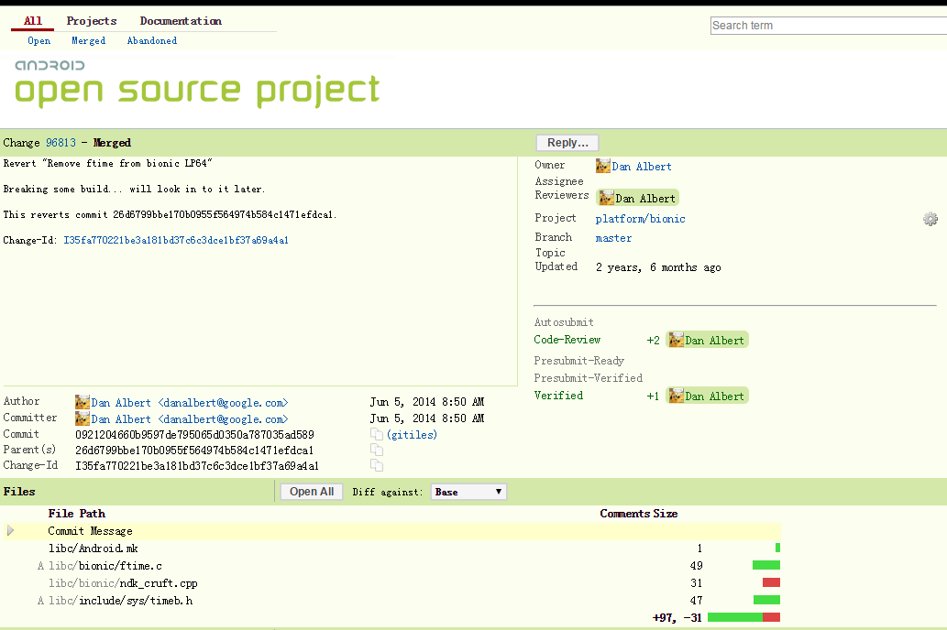
Reverting commit
Reverted commit

Slide 3
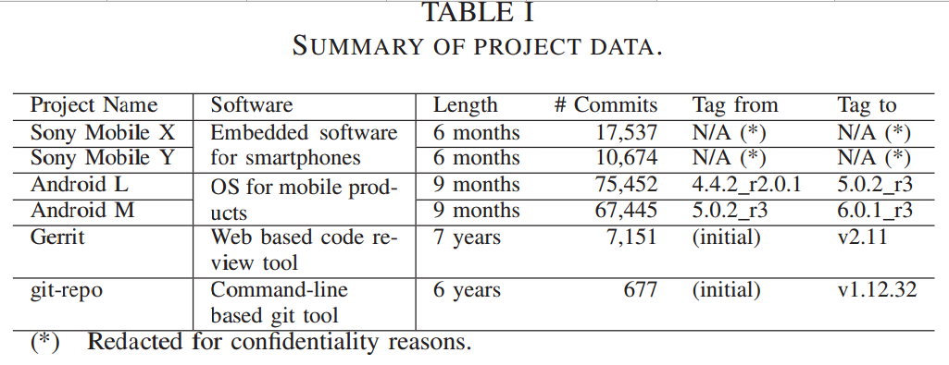

Slide 4
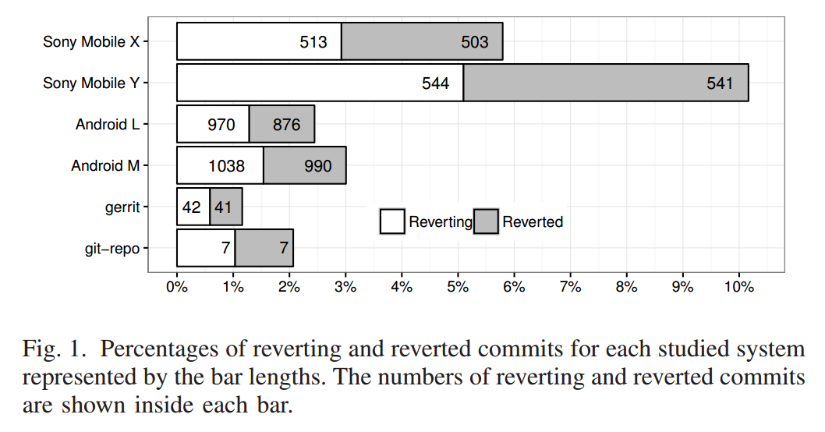
RQ1: What percentage of commits are being reverted?

Slide 5
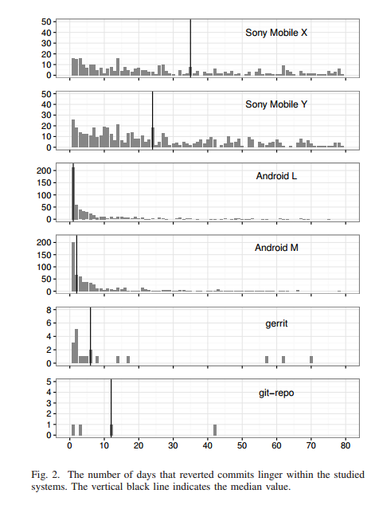
RQ2: How long do commits that are eventually reverted linger within a codebase?

Slide 6
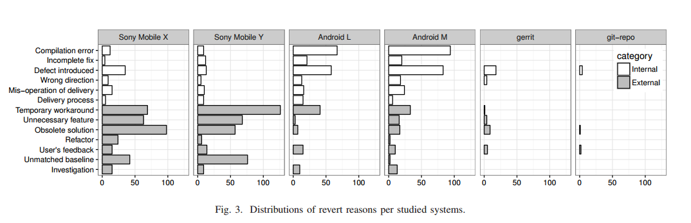
RQ3: Why are commits being reverted?

Slide 7
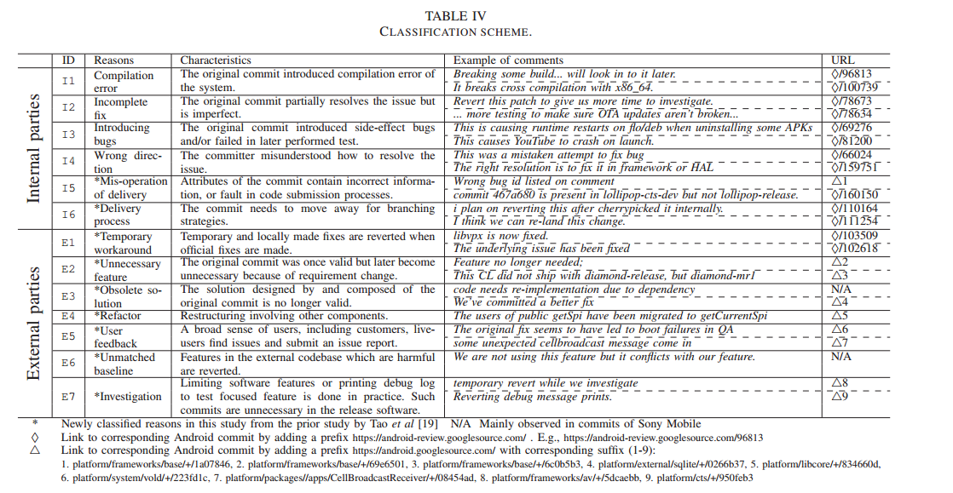

Slide 8
Revert change prediction
Two challenges
1. Class imbalance
2. Feature extracting

Slide 9
Challenge I
1. Class imbalance
Two solutions
1. Imbalance-aware classifier
2. Resampling

Slide 10
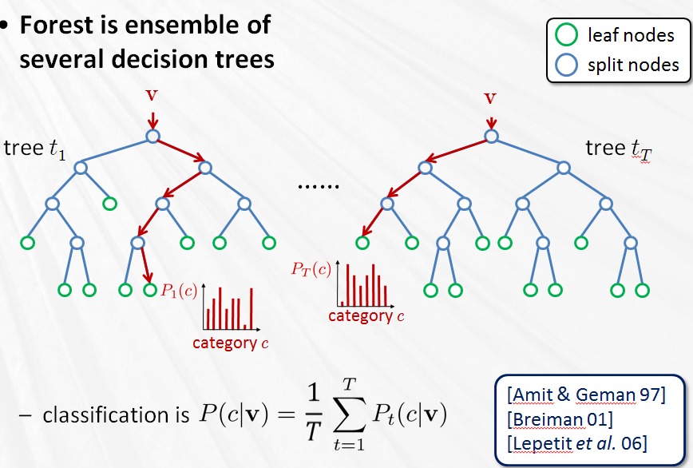
Solution 1: Imbalance-aware Classifier
Adaptively threshold learning in random forest
Cross-Project Build Co-change Prediction, Xia et al. SANER 2015

Slide 11
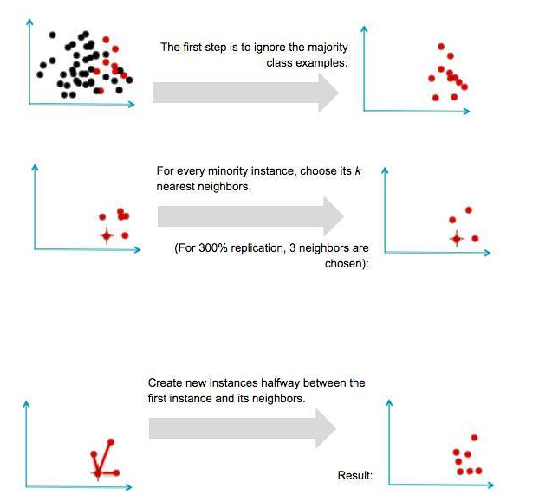
Solution 2: Resampling
SMOTE
1. Predicting Build Co-Changes with Source Code Change and Commit Categories, , McIntosh et al. SANER 2016
2. Learning from imbalanced data, He et al., TKDD,2009

Slide 12
Challenge II
2. Feature extracting
Three feature groups

Slide 13
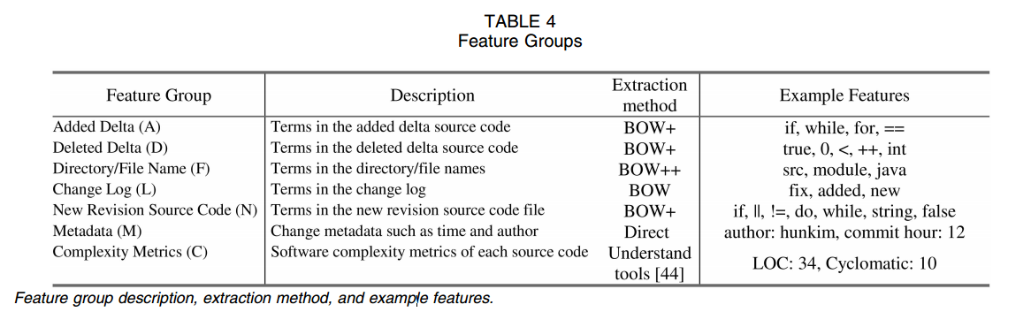
Feature group 1
Classifying software changes:clean or buggy? , Sunghun Kim et al. TSE, 2008.

Slide 14
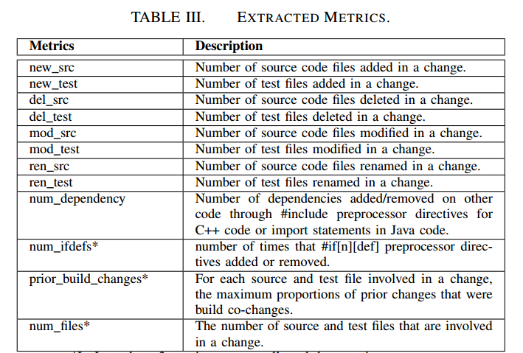
Feature group 2
Cross-Project Build Co-change Prediction, Xia et al. SANER 2015
Mining co-change information to understand when build changes are necessary, McIntosh et al. ICSME 2014

Slide 15
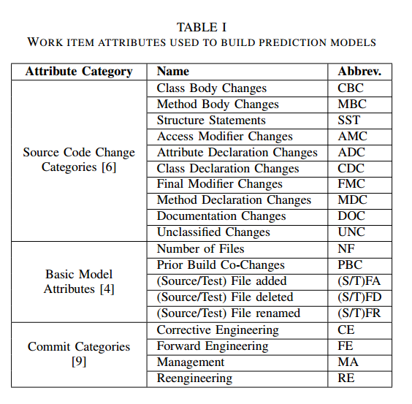
Feature group 3
Predicting Build Co-Changes with Source Code Change and Commit Categories, , McIntosh et al. SANER 2016

